Slide 1
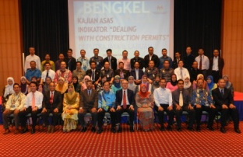
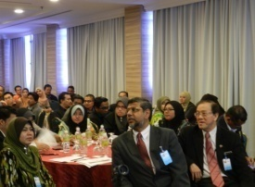
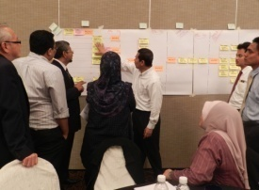
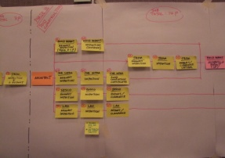
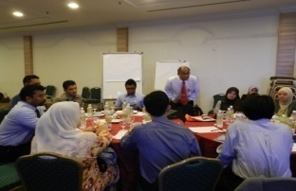
NEW MODEL OSC
RESEARCH AND TECHNICAL LEGISLATION DIVISION, LOCAL GOVERNMENT DEPARTMENT

Slide 2
WORLD BANK REPORT MEASURING BUSINESS REGULATIONS
World Bank
Report
Doing Business Report 2014
6
Getting Credit 1
Protecting Investors 4
Trading Across Border 5
Paying Taxes 36
Getting Electricity 21
Registration Properties 35
Enforcing Contract 30
Resolving Insolvency 42
Starting a Business 16
Dealing With Construction Permit 43
2014
189 Countries
12
2013
18
2012

Slide 3
EASE OF DOING BUSINESS IN MALAYSIA
Dealing With Construction Permits
43
What Being Measured
2014
PROCEDUR
Total of interaction between investors and regulators
189 Countries
TIME
Time taken by regulators
96
2013
COST
Processing Fess (% of GNI / capita)
2012
113

Slide 4
PHASE AND PROCESS
Start
End
P1
P2
P3
P4
P5
Pre Consultation
Approval
Notification To Start Work
Final Inspection I
Final Inspection II
Deposit CCC and G Forms
Process 1
Process 2
Process 3
Process 4
Process 5

Slide 5
PROCESS 1
PRE-CONSULTATION
APPLICANT
Gather technical requirement
1.1
Layout Plan
Estimated water supply cosumption
Layout Plan
Estimated electrical supply cosumption
Layout Plan
Layout Plan
PBAN
Tapping point
Pressure at tapping point
TNB
source of electric supply
SKMM
Relevant NFPs
Tapping point of relevant NFP
1.2
1.3
1.4
PTG/PTD
Type of land application to be settled
1.5
14 DAYS
APPLICANT
Received technical input from 4 technical agencies
Prepare documentations for formal submission
1.6
Note :
Validity of technical input is 3 months from issuances of input
Formal submission to OSC within the validity period
Improvements
Data gathering process streamlined and monitored
Technical requirements made known prior to formal submission
Benefit genuine investors
RESEARCH AND TECHNICAL LEGISLATION DIVISION, LOCAL GOVERNMENT DEPARTMENT

Slide 6
PROCESS 2
APPROVAL
2.1
PSP
Complete Submission
SIMULTANEOUS APPLICATION OR STAGGERED
2.2
2.2
Checking of Document
OSC
Request Additional Document
No
Complete?
Ya
2.7
LAND MATTERS
State Land Office
124A
204D
Others
PLANNING PERMISSION
Planning Department, PBT
Planning Plan
Name of road
Name of Scheme
Lanscape Plan
2.5
ENGENEERING PLAN
Engineering Department, PBT
Structural Plan
Earth Work Plan
Work and Drainage Plan
Street Lighting Plan
Utility Plan
Excavation Permit
Transfer of Earth Permit
Public Road Usage Permit
EXTERNAL TECHNICAL AGENCIES
JPS
SKMM
JBPM
PTN/PTG
TNB
JMG
IWK
JAS
JPBD
PBAN
JKR
2.3
2.4
BUILDING PLAN
Building Department, PBT
Building Plan
Hoarding Permit
Roro bin permit
2.6
2.8
OSC
Approval after fulfill the amendments
To be continued
RESEARCH AND TECHNICAL LEGISLATION DIVISION, LOCAL GOVERNMENT DEPARTMENT
Notes:
Ir

Slide 7
PROCESS 2
PLAN APPROVAL
Continued
2.9
OSC COMM MEETING
2.10
OSC
2.12
INTERNAL TECHNICAL DEPARTMENT PBT
Issue official decision
Endorse plans
FULL COUNCIL
endorsement
2.11
2.13
PTN
Table Land Matters to States Exco
Forward state’s decision to OSC
2.14
OSC
Coordinate and compile
Issue endorsed plans
Amendment of plans to be submitted to
JK OSC consideration
2.15
PSP/SP
Improvements
Single in single out process
Reduce interactions between business to
agencies
RESEARCH AND TECHNICAL LEGISLATION DIVISION, LOCAL GOVERNMENT DEPARTMENT
Notes:
Ir

Slide 8
PROCESS 3
NOTIFICATION TO START WORK
PSP
Deposit Notification
3.1
Deposit Checklist
Project Implementation Schedule
Declaration complying with IWK
Declaration complying with JPS
Declaration complying with SKMM
Declaration complying with PPSPA
List of consultants involved in projects
Land Certificate
infrastructure fund payment by check / money order / bank draft
JKJ Form
B Form
B Form (Earth Work)
PDC 6
OSC
Distribute notices to agencies
3.2
BUILDING DEPARTMENT
Receive B Form, Second Schedule UBBL 1984
DOSH / OTHERS AGENCY
Receive notification
3.3
3.4
3.5
3.6
ENGINEERING DEPARTMENT
Receive B Form, Earth Work by law
APP (IWK/MAJAARI)
ReceivePDC 6, MSIG
VOL II
Improvements
Reduce interaction
RESEARCH AND TECHNICAL LEGISLATION DIVISION, LOCAL GOVERNMENT DEPARTMENT

Slide 9
PROCESS 4
FINAL INSPECTION (TESTING AND COMMISSIONING, REPORTS, CONNECTION, ISSUANCE
OF CLEARANCE LETTER)
Note :
Substation to be handed over to TNB once completed
PSP
Submit request for inspection with testing and commissioning report
5.1
Final inspection I for scope PBAN, TNB, PBT / IWK
Application for Communication Connection.
Final Inspection II for JPBM, DOSH, APP (IWK/MAJAARI), PBT/JKR
5.2
OSC
Issue notices for final inspection
Monitor final inspection
Flag off
OSC inform NFP to do connection
FINAL INSPECTION I
NFP
Communication Connection
5.4
5.4
5.5
5.6
5.3
PBAN
Final Inspection
Utility Connection
Report Submission
Meter connection & Clearance letter CCC
5.5
PBT / JKR
Final Connection
Clearance letter CCC
TNB
Final Inspection
Electrical
Connection
Clearance letter CCC
FINAL INSPECTION II
5.7
JBPM
Final Connection
Clearance letter CCC
5.8
DOSH
Final Connection
Clearance letter CCC
APP (IWK/MAJAARI)
Final Connection
Clearance letter CCC
5.9
Improvements
Structured and monitored inspections
Clearance letters issued immediately
Testing and commissioning of systems based on supplies designed for the development
Reduce interaction
PSP
Receive clearance letters CCC
5.10
RESEARCH AND TECHNICAL LEGISLATION DIVISION, LOCAL GOVERNMENT DEPARTMENT

Slide 10
PROCESS 5
DEPOSIT CCC AND G FORM
PSP
• Deposit 2 copies CCC & Form G within 14 days after CCC issued
6.1
CCC
From G1 – G21
6.2
OSC
Receive & distribute
CCC
Form G1 – G21
CCC
Form G1 – G21
6.3
6.4
BUILDING DEPARTMENT
Record & file CCC & Form G1 – G21
LAM/LJM
Record & file CCC & Form G1 – G21
Improvements
Reduce interaction
Leaner process
RESEARCH AND TECHNICAL LEGISLATION DIVISION, LOCAL GOVERNMENT DEPARTMENT

Slide 11
THANK YOU…….
RESEARCH AND TECHNICAL LEGISLATION DIVISION, LOCAL GOVERNMENT DEPARTMENT

